Slide 1

Shree Shambhubhai V. Patel College of Computer Science and Business Management
In partial fulfillment for the award of the degree
Of
BACHELOR OF COMPUTER APPLICATION
[B.C.A]
Year 202`2-2023
BCA-5th SEMESTER
Submitted to:
SUBMITTED BY: GUIDED BY:
Vimal Bhesaniya [008] Prof Bipinbhai Jadav

Slide 2
Contents
Introduction
System Flow Chart
DFD/ UML Diagram
ER Diagram
System Design
Reference

Slide 3

Introduction
Project Title: Job Portal Platform
Project Description:
The Job Portal Platform is an online web-based system designed to connect job seekers with employers, providing a seamless and efficient platform for job searching and recruitment. This small project description outlines the key features and functionalities of the Job Portal Platform:

Slide 4
Project Profile
Project Title : | JobXpress
Front-End : | React-JS
Back-End : | Node-JS
Browser : | All Browser Supported
Technology: | JavaScript, Bootstrap, MongoDBCompass, Express-JS
Guided By: | Prof. Bipinbhai Jadav
Platform : | 16.14.0
Tools Used For: | Visual studio, MongoDBCompass, Postman
Submitted To: | Shree Shambhubhai v. Patel college of computer science
Developed By: | Vimal Bhesaniya

Slide 5
3. System Flow Chart

Slide 6
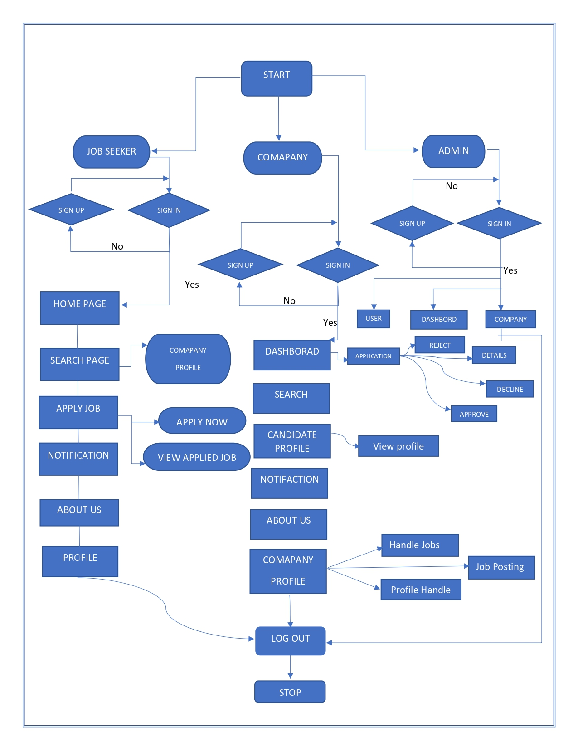

Slide 7
4. Data flow diagram

Slide 8
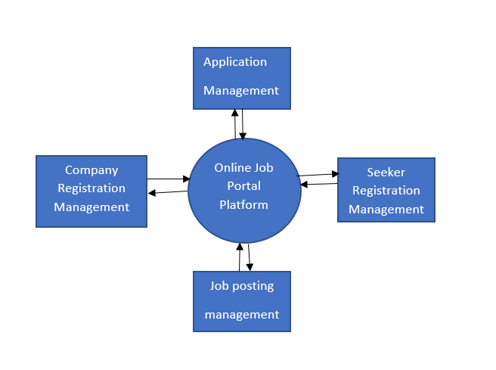
Contexct leval

Slide 9
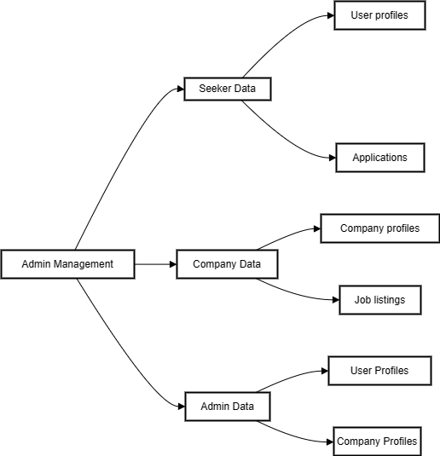
Laval 1 DFD

Slide 10
5. Entity-relationship diagram

Slide 11
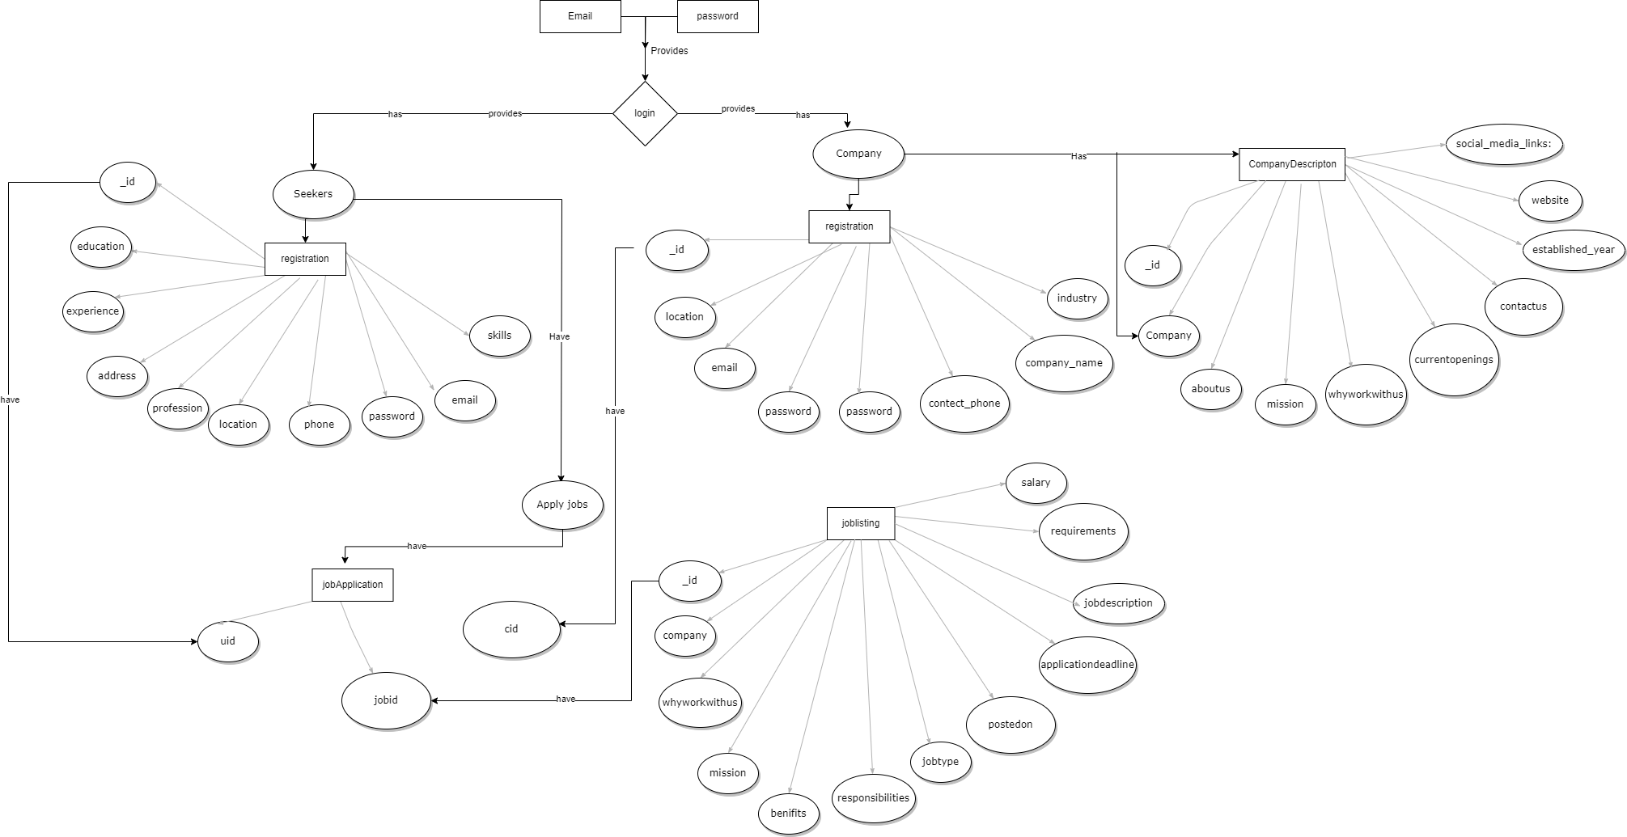

Slide 12
5. Screen Shots

Slide 13
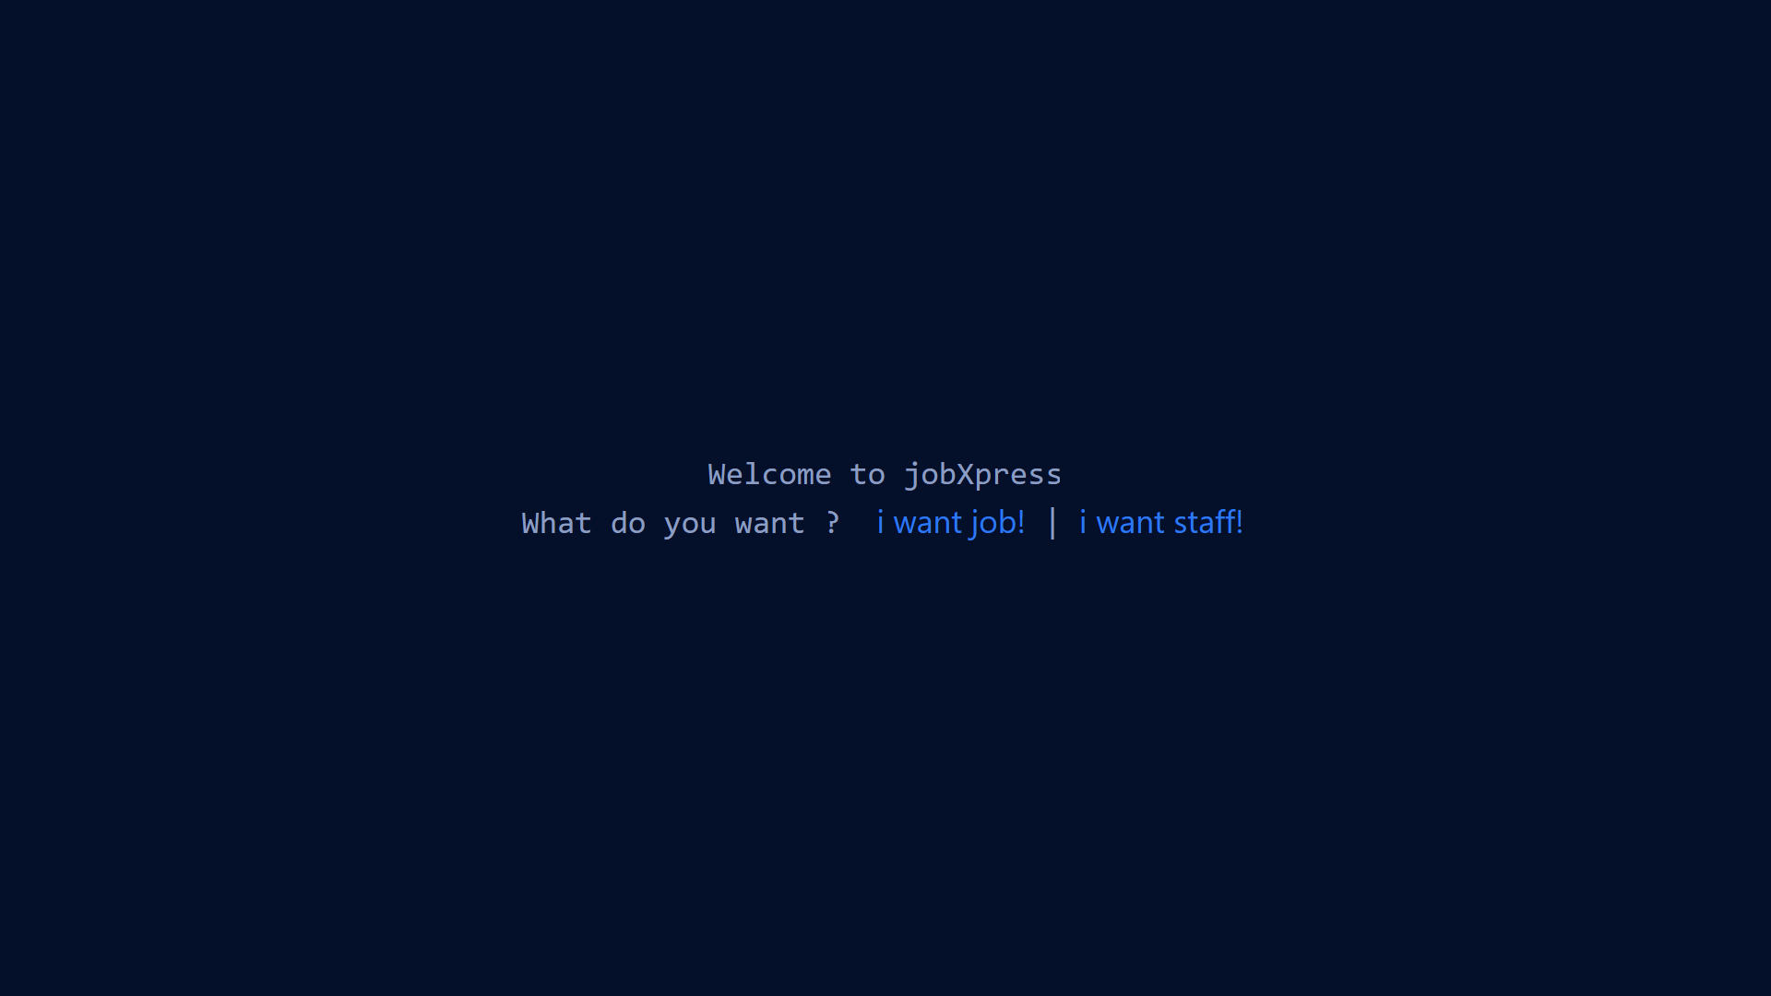
Entry Screen [User Side]

Slide 14
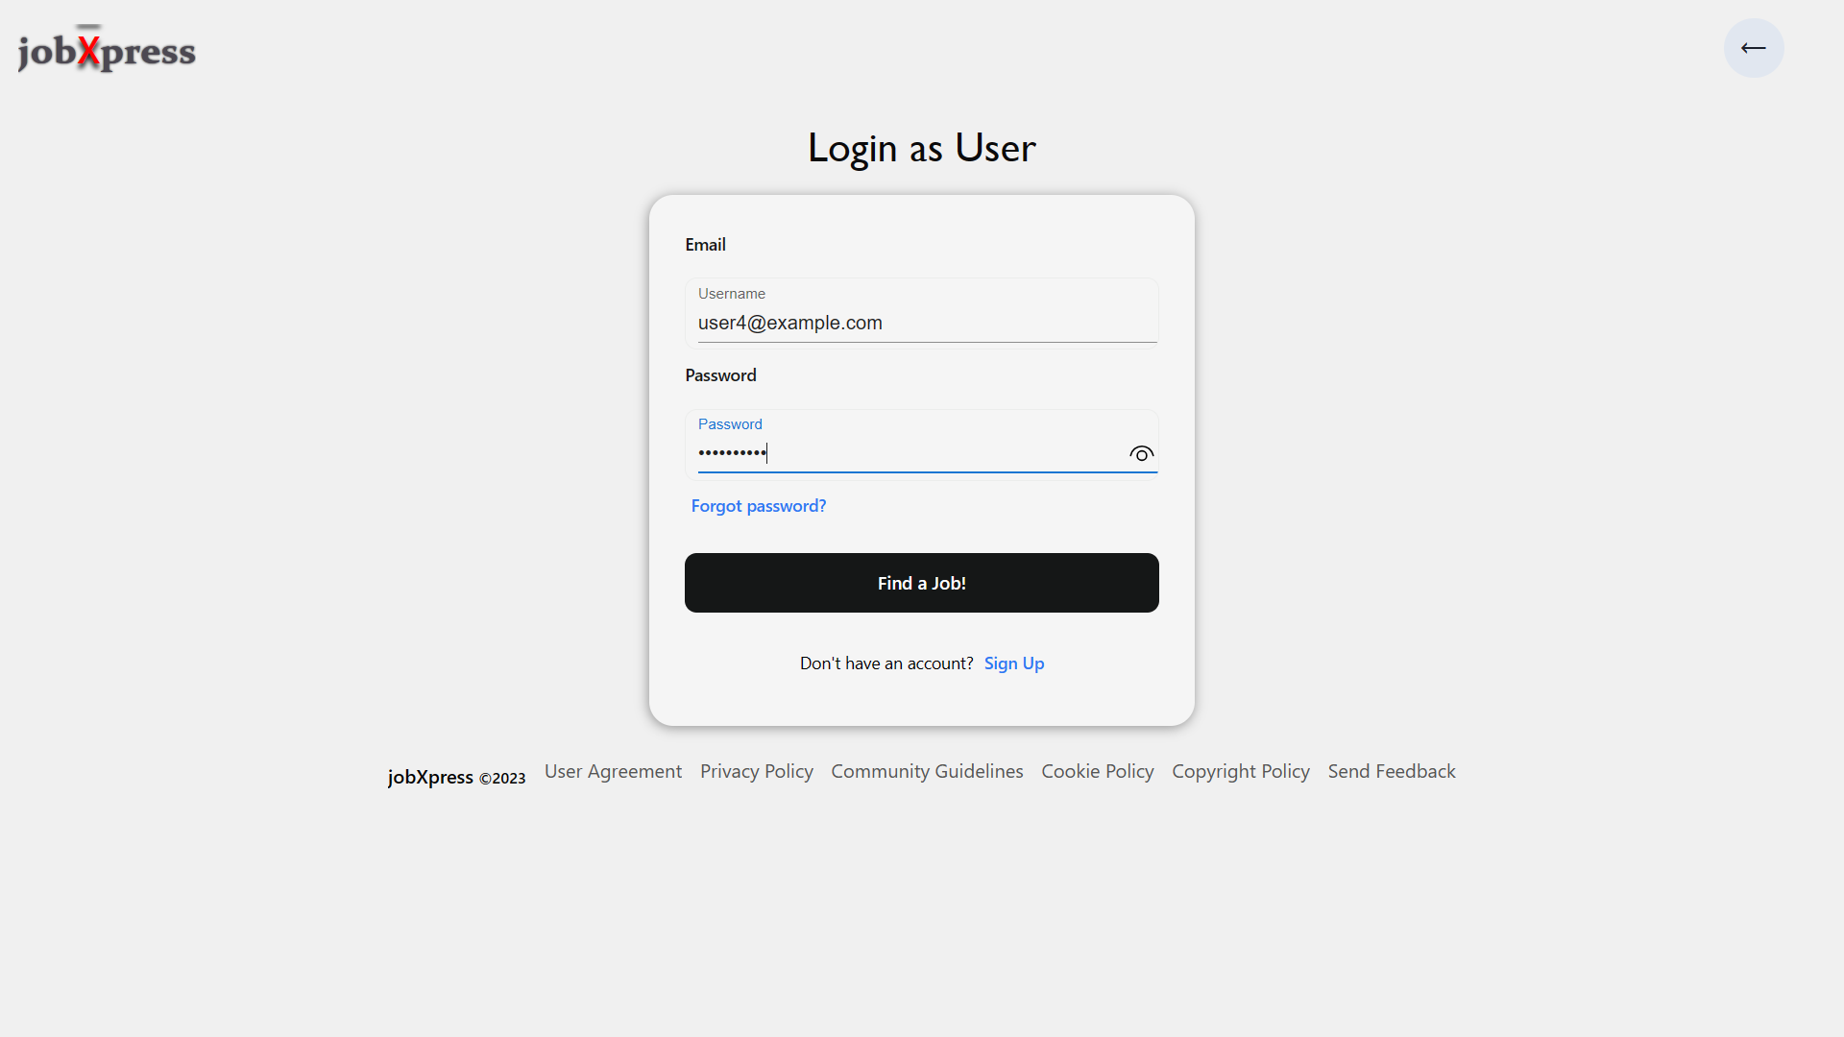
User Login Screen

Slide 15
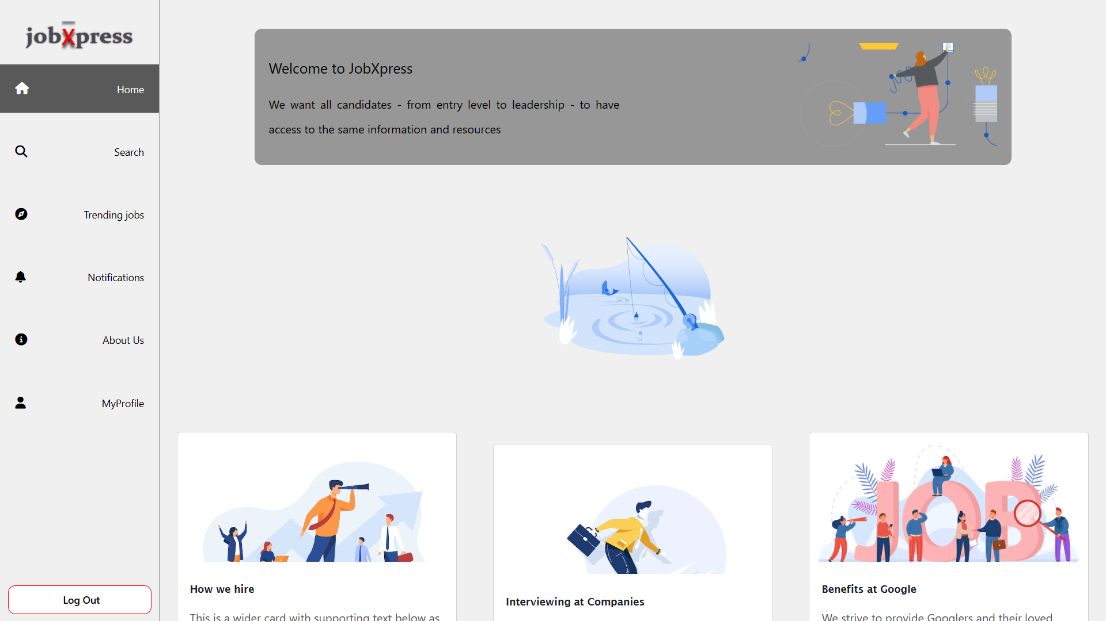
HomePage Screen

Slide 16
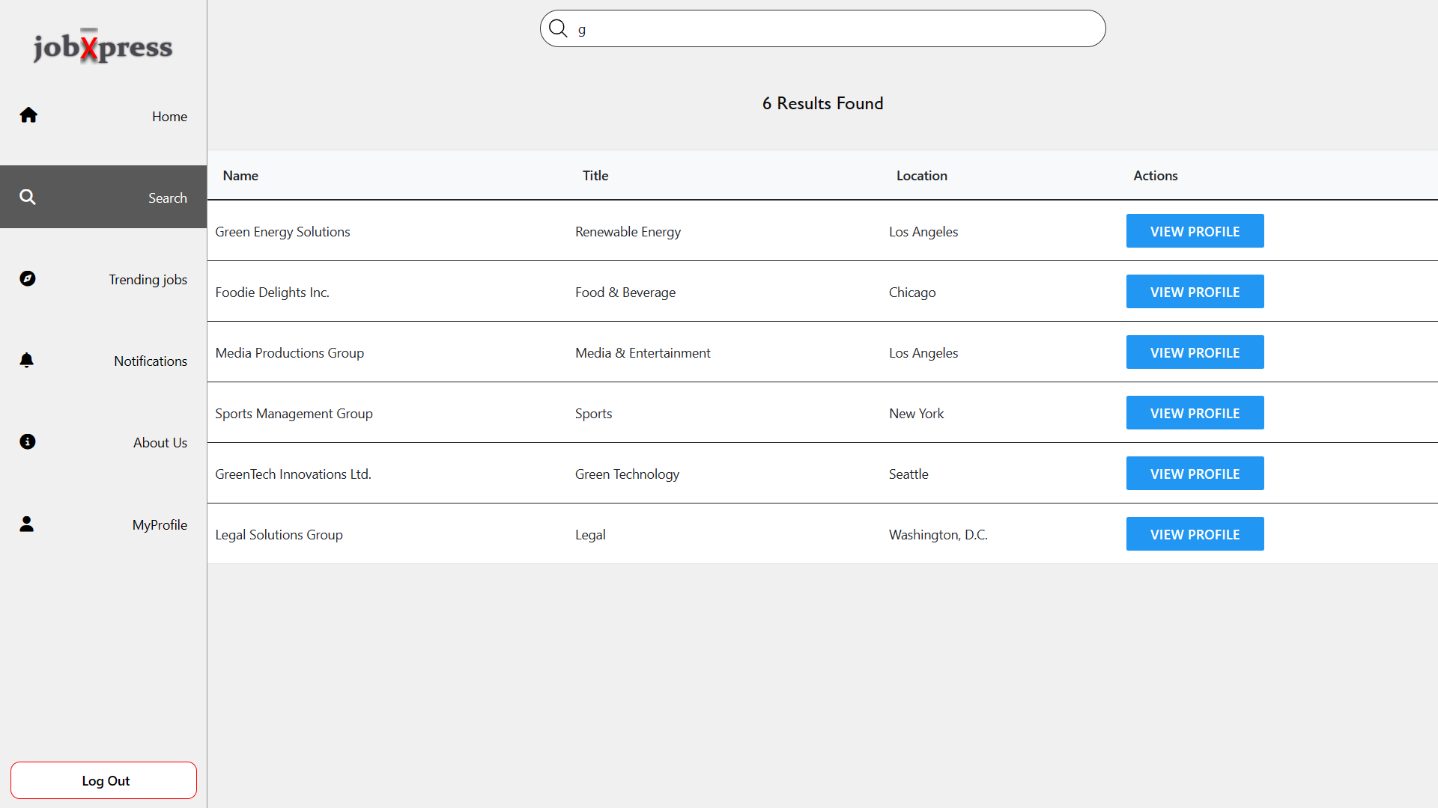
SearchPage : By Companies , Location etc.

Slide 17
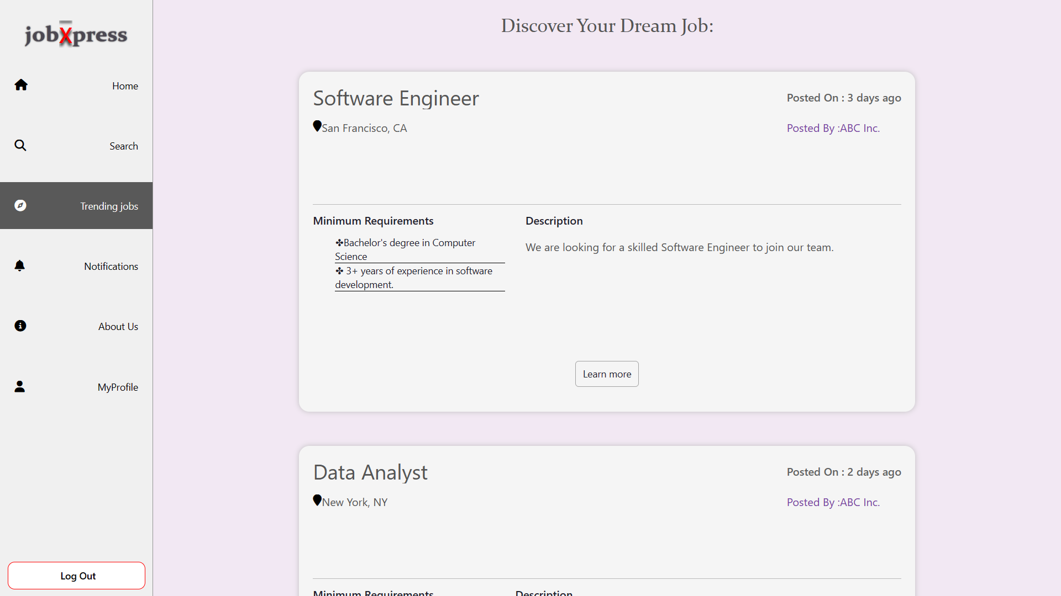
Trending Jobs Screen

Slide 18
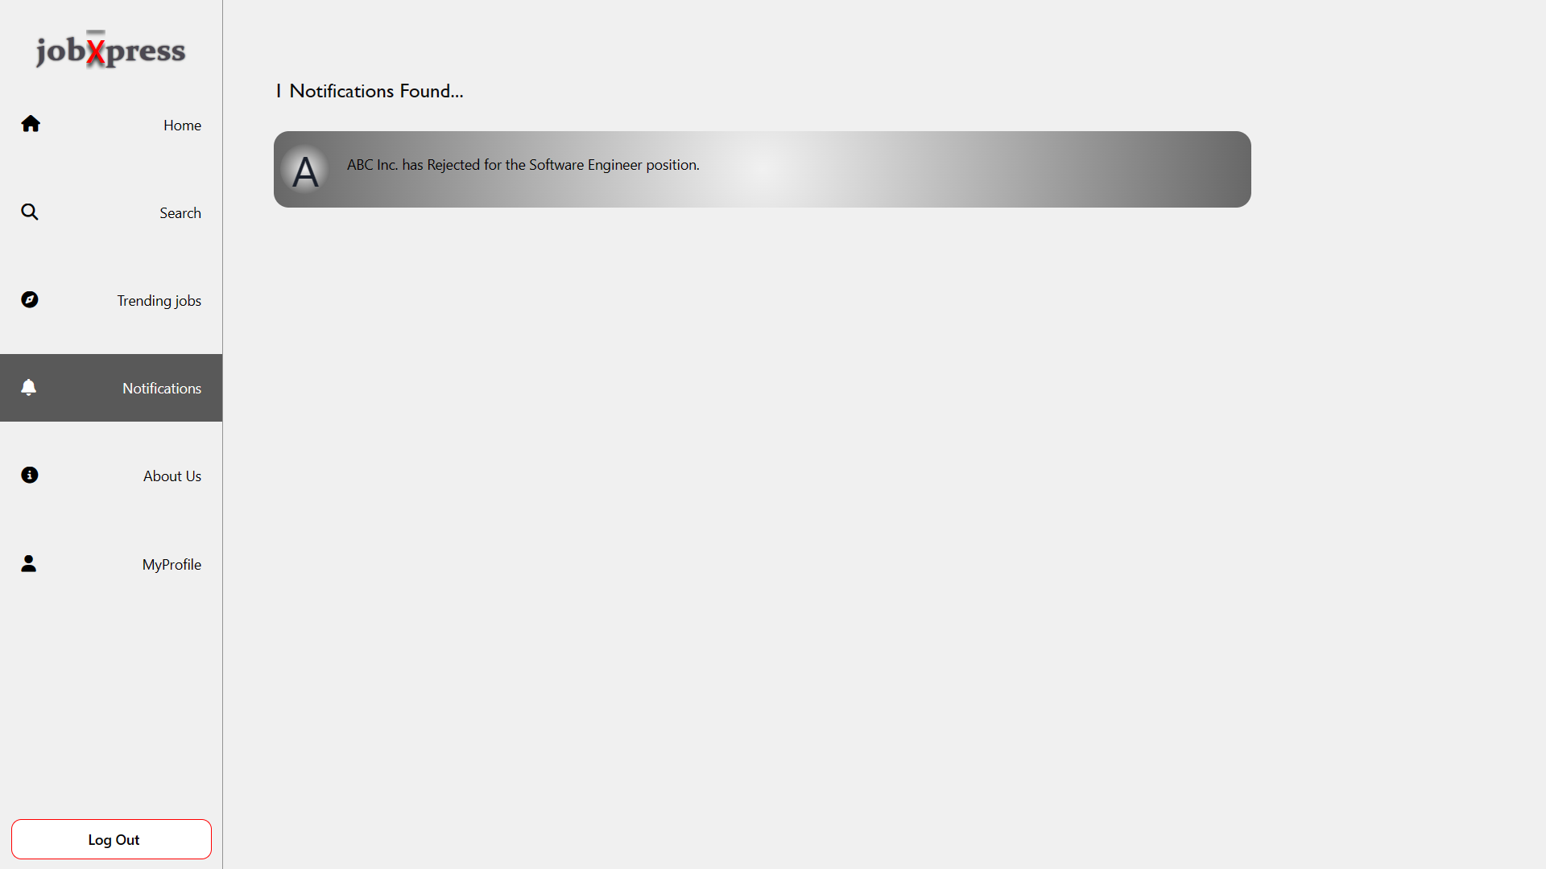
Notifications

Slide 19
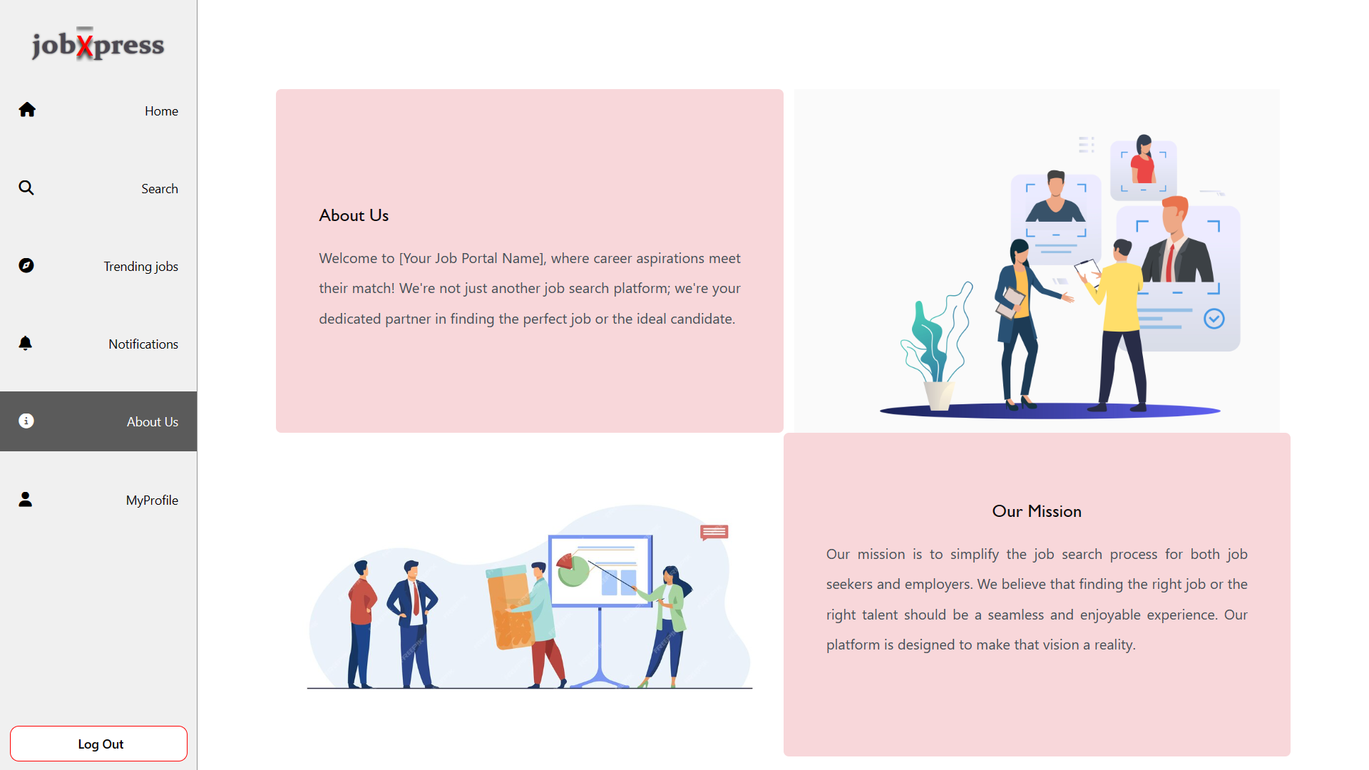
About Us

Slide 20
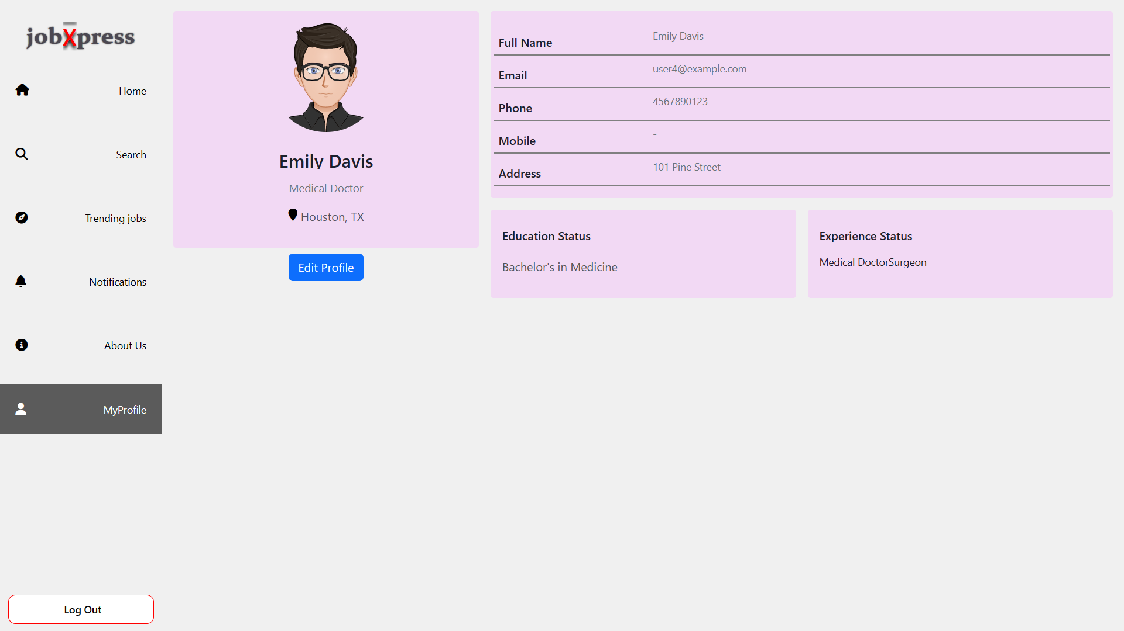
User Profile

Slide 21
Company Side

Slide 22
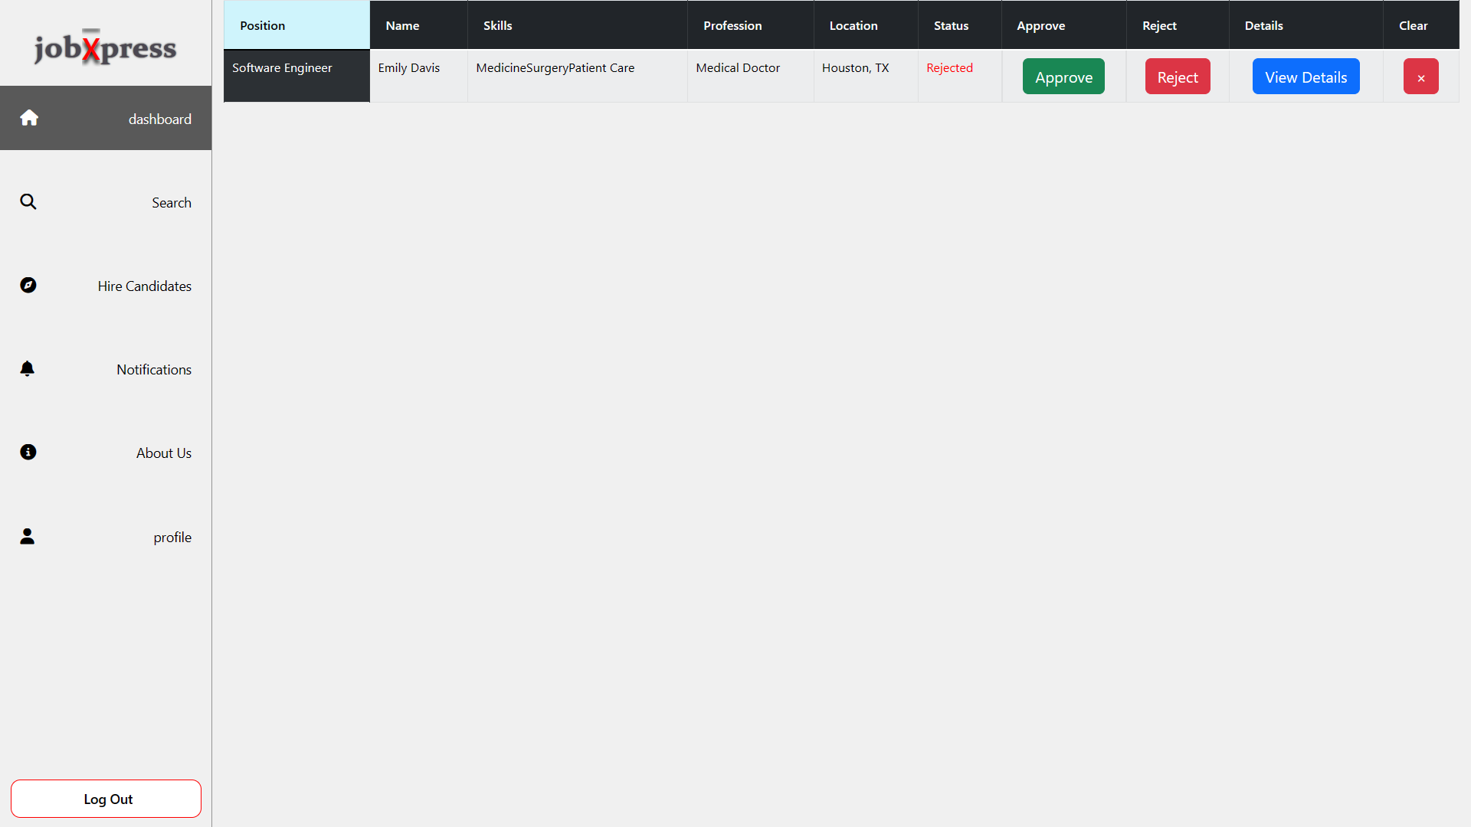
Company Dashboard

Slide 23
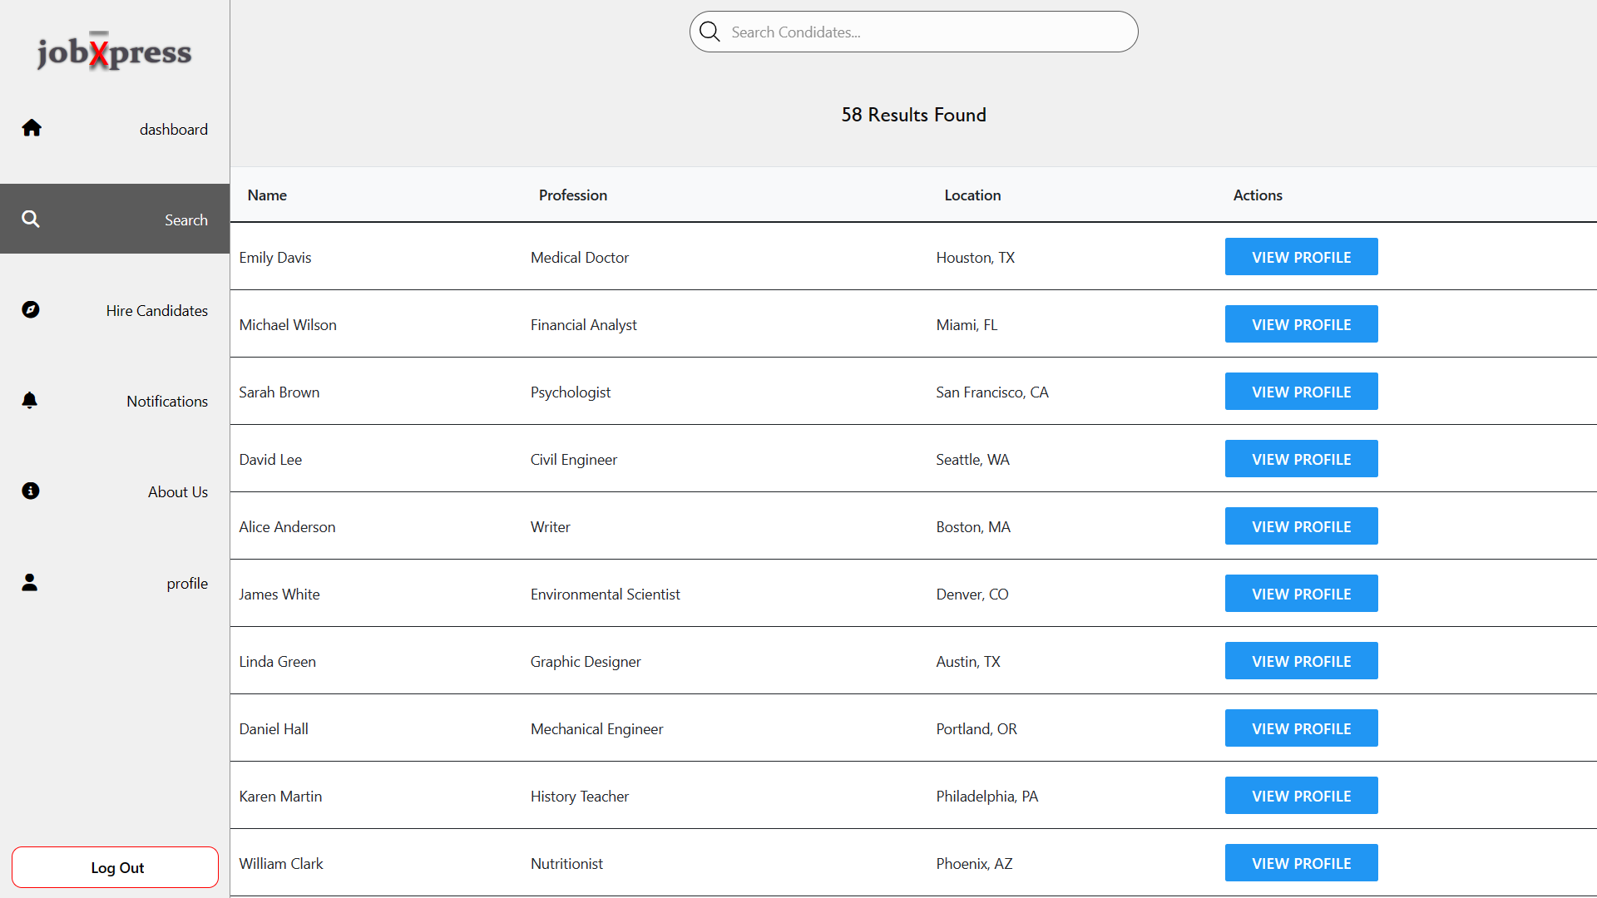
Search Page

Slide 24
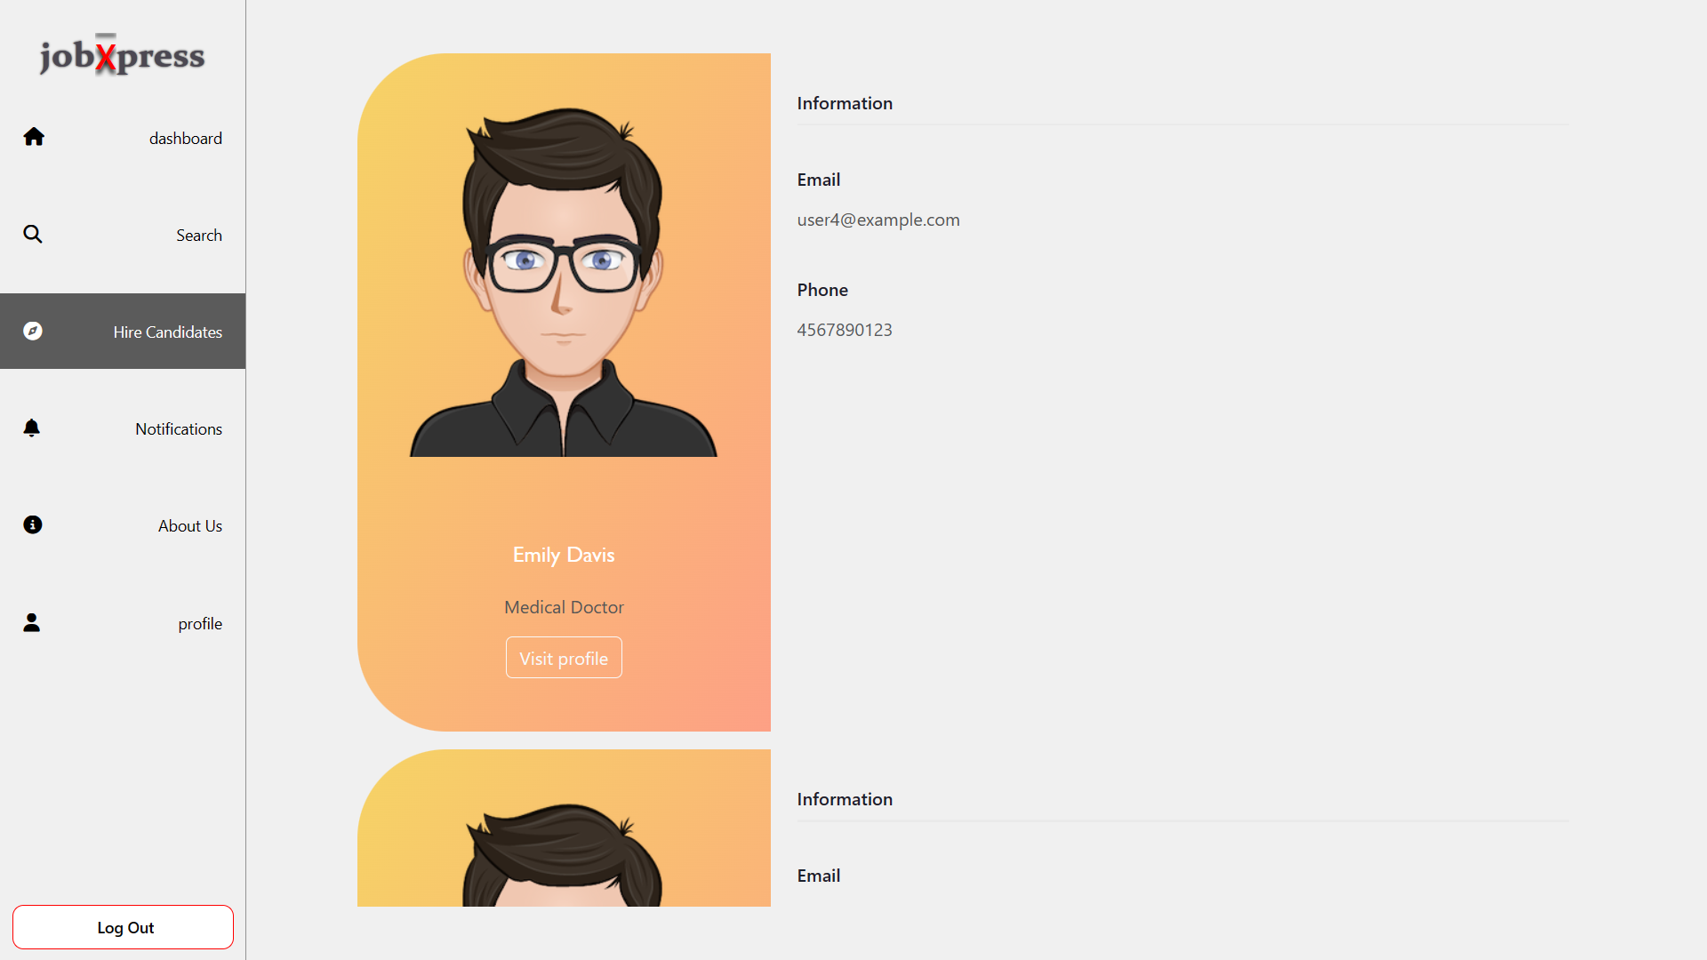
Candidate profile`s

Slide 25
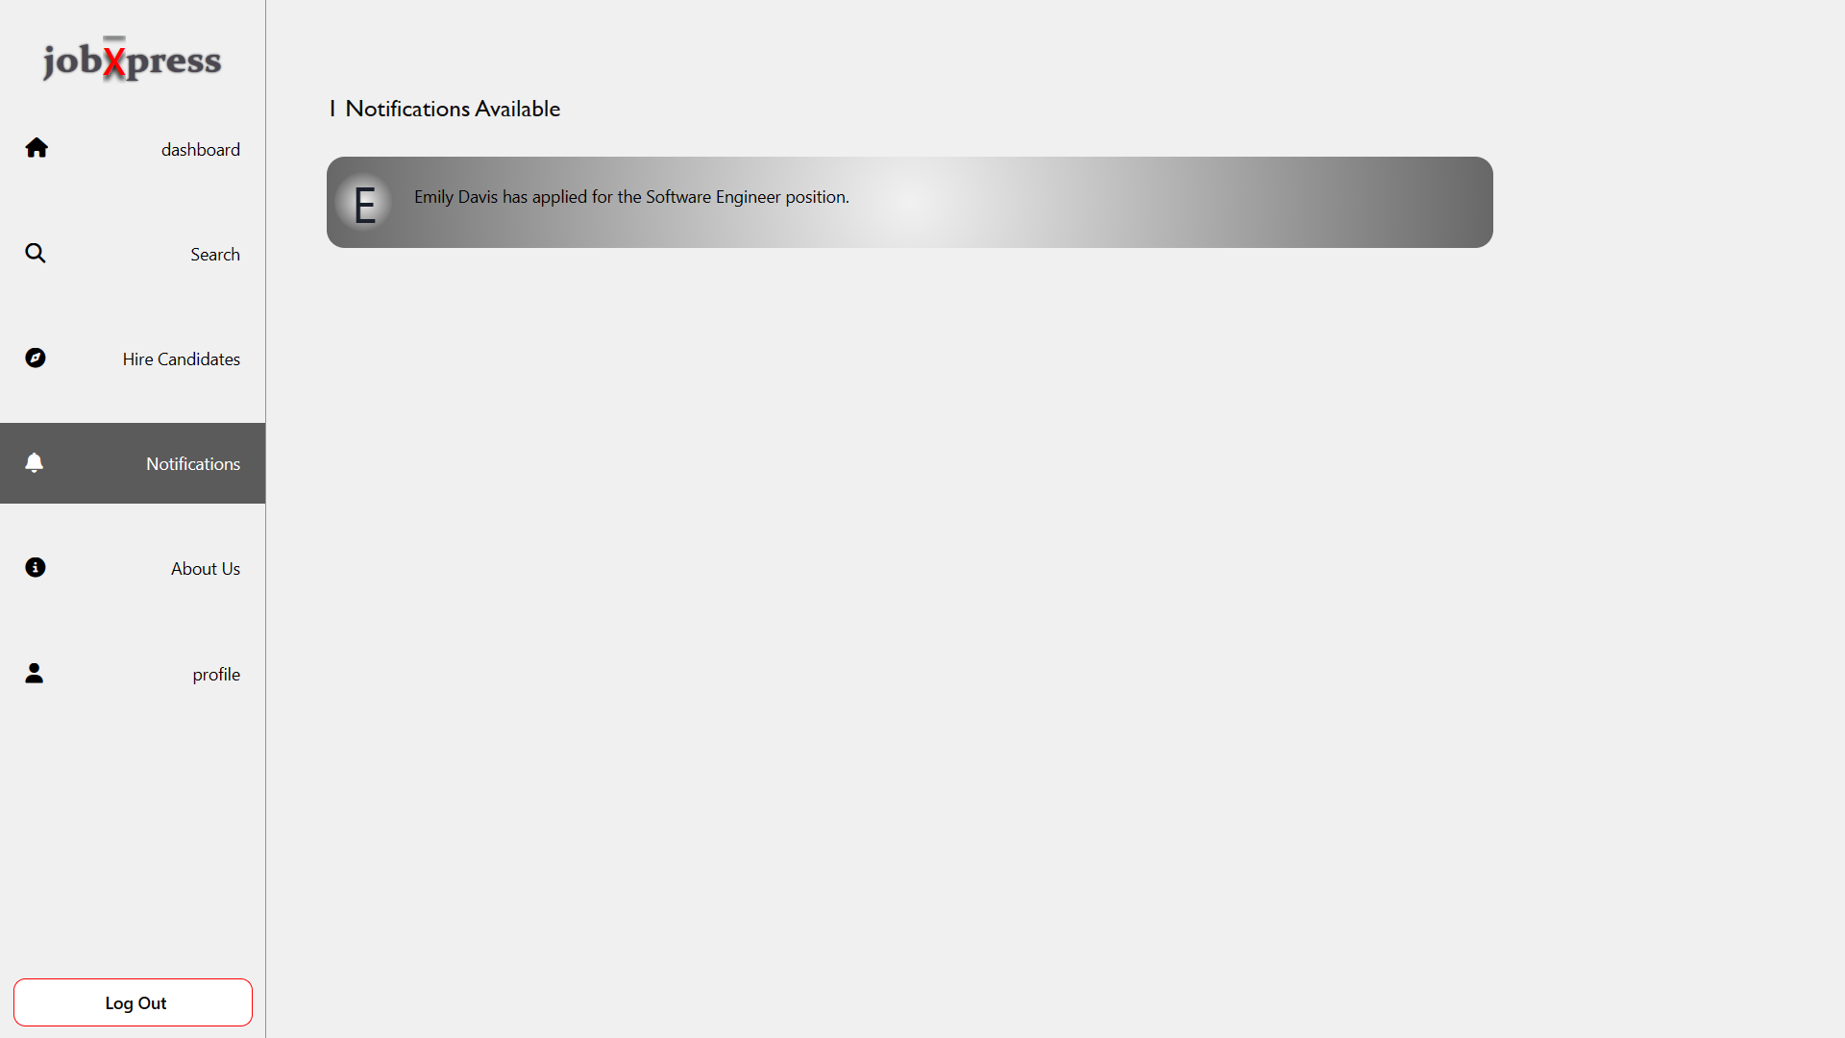
Company Notification

Slide 26
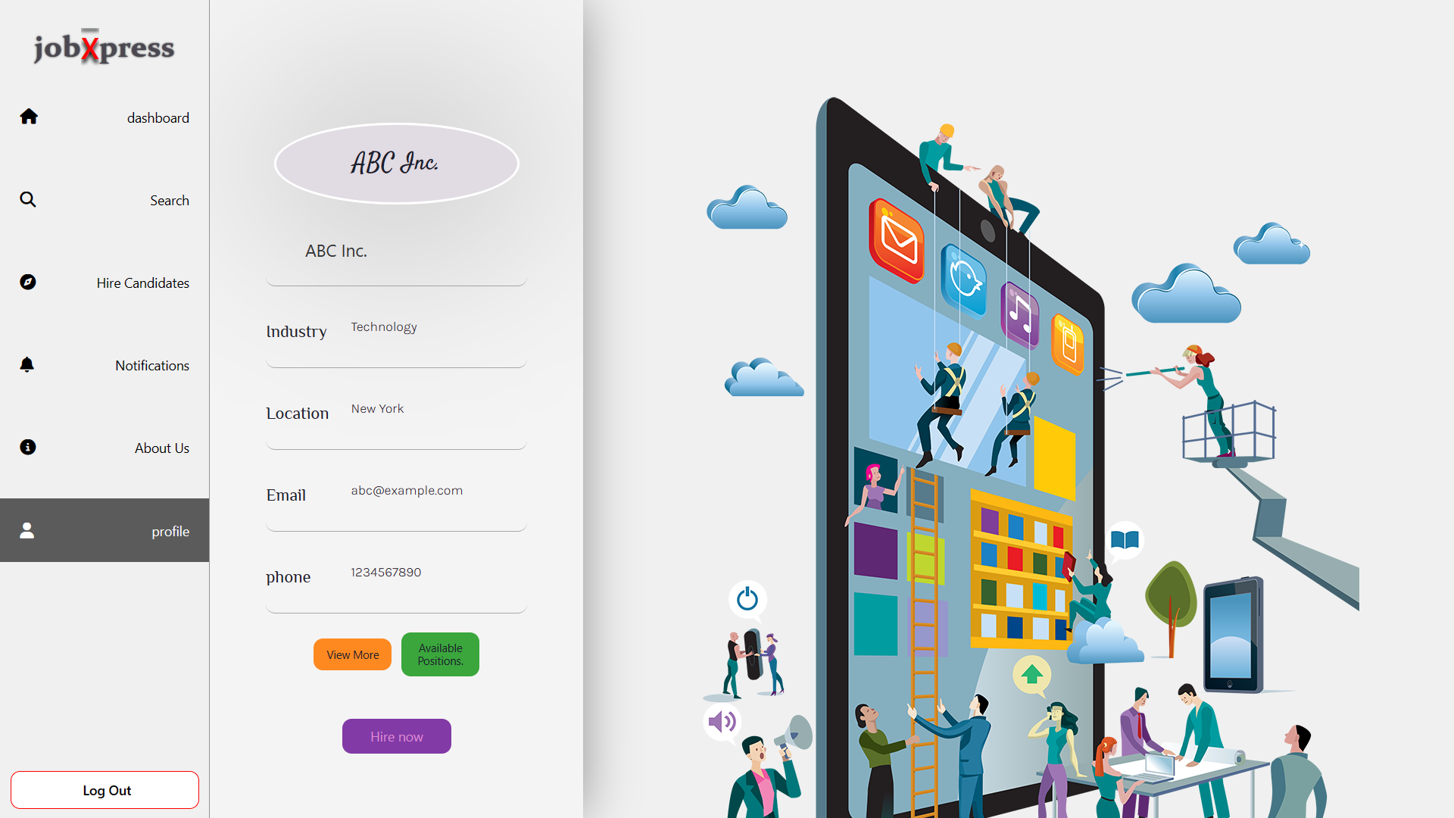
Company Profile

Slide 27
Admin Side

Slide 28
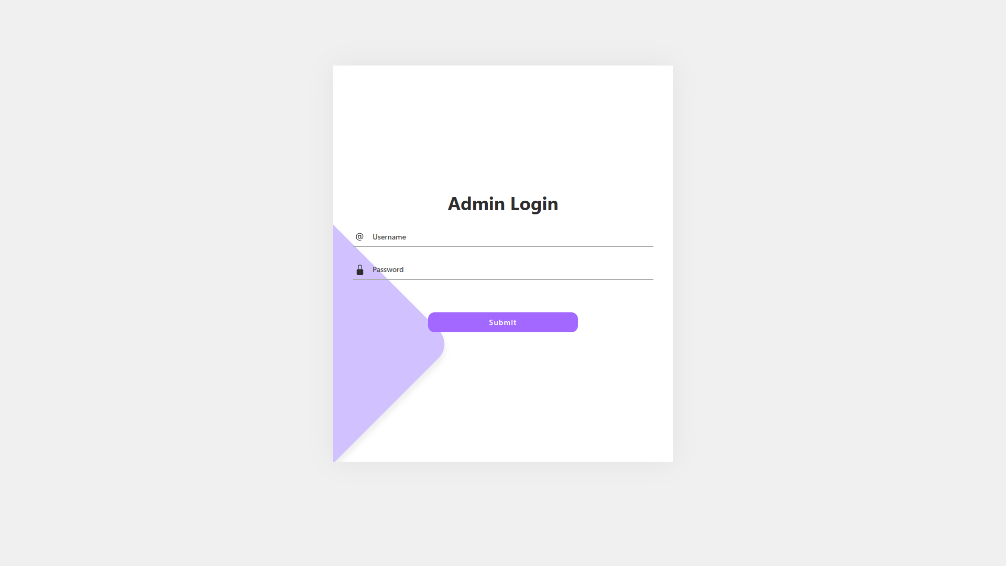
Admin login

Slide 29
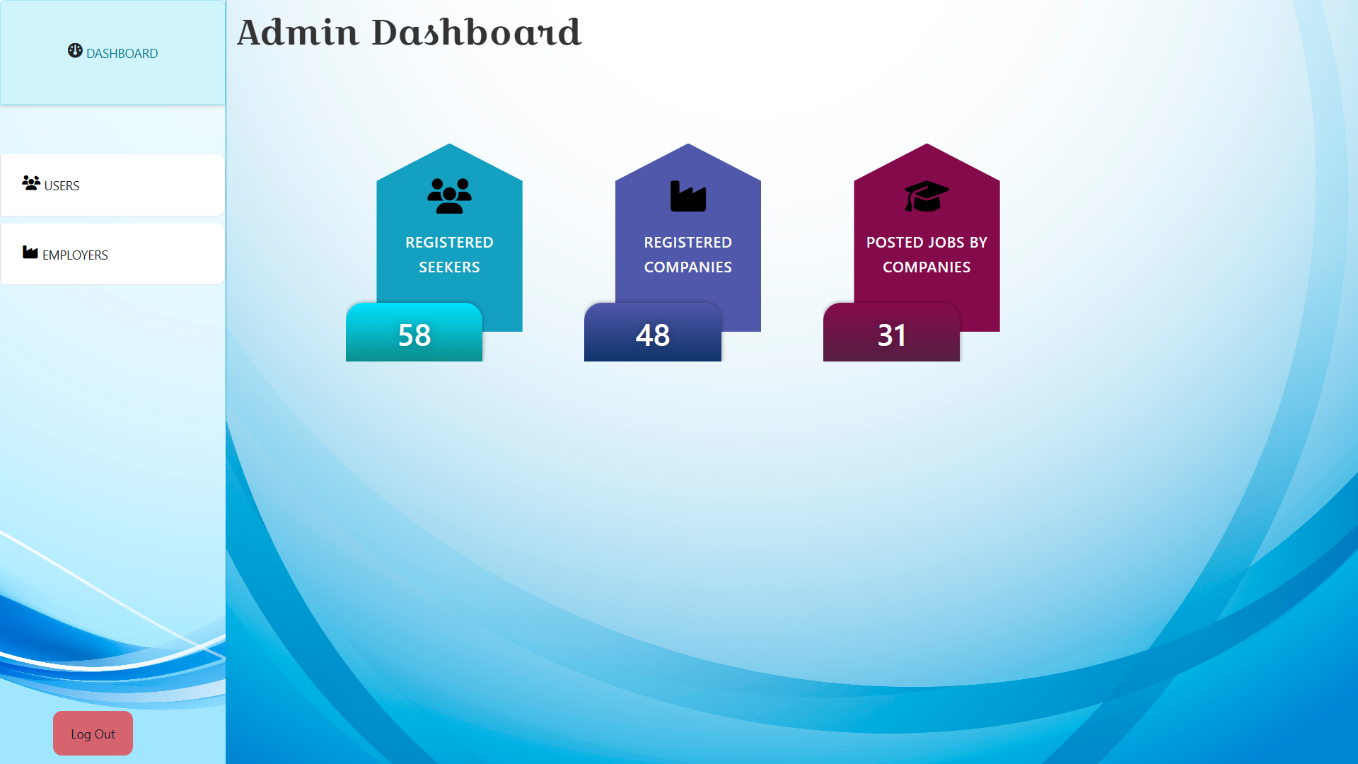
Admin dashboard

Slide 30
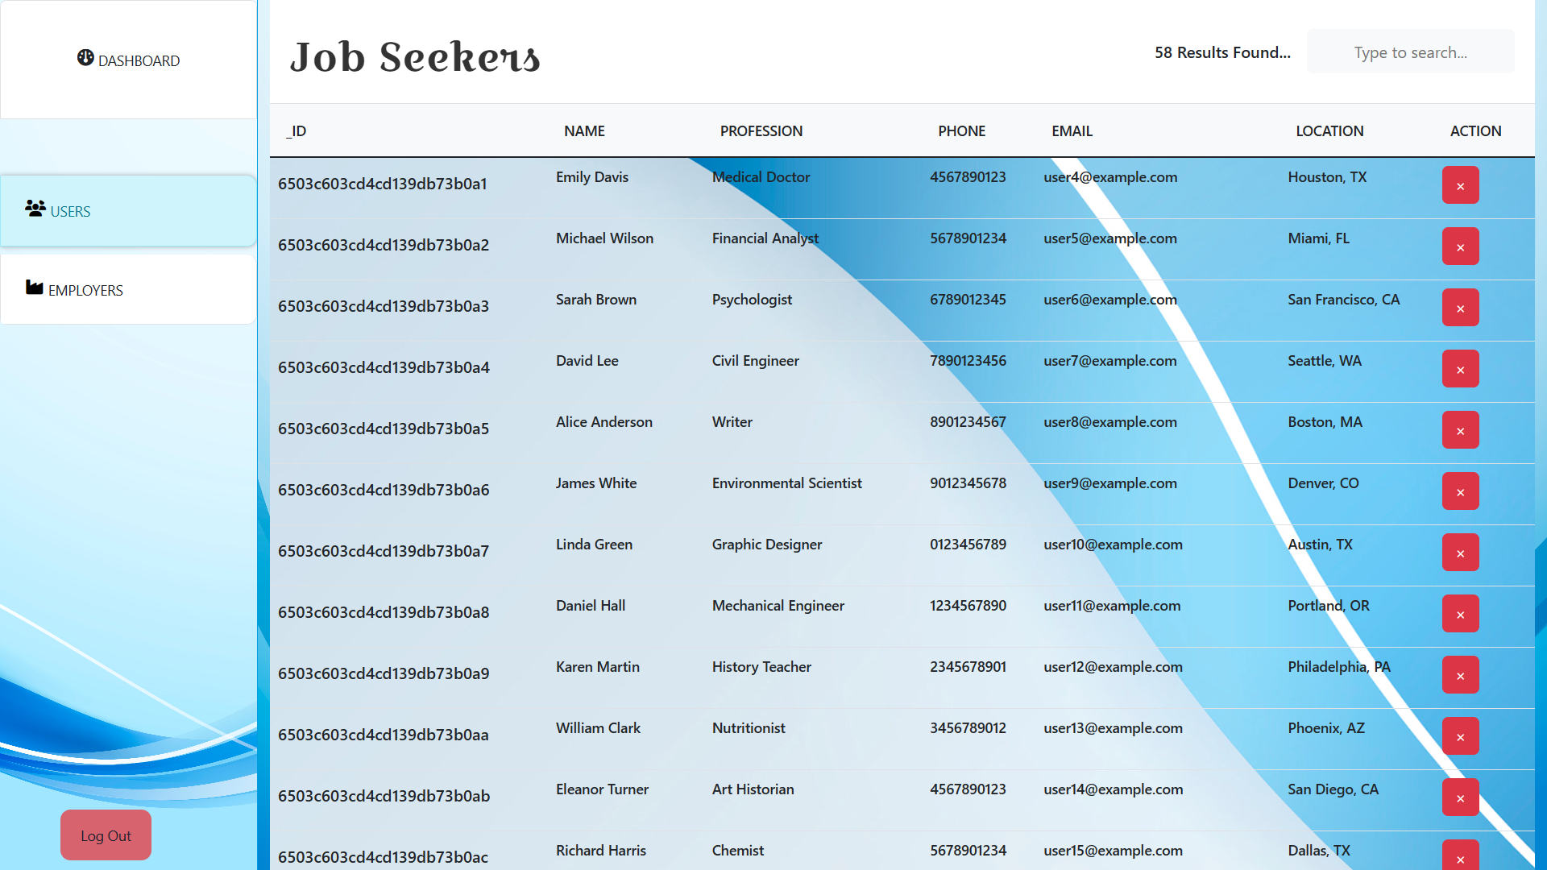
Job seekers Handling

Slide 31
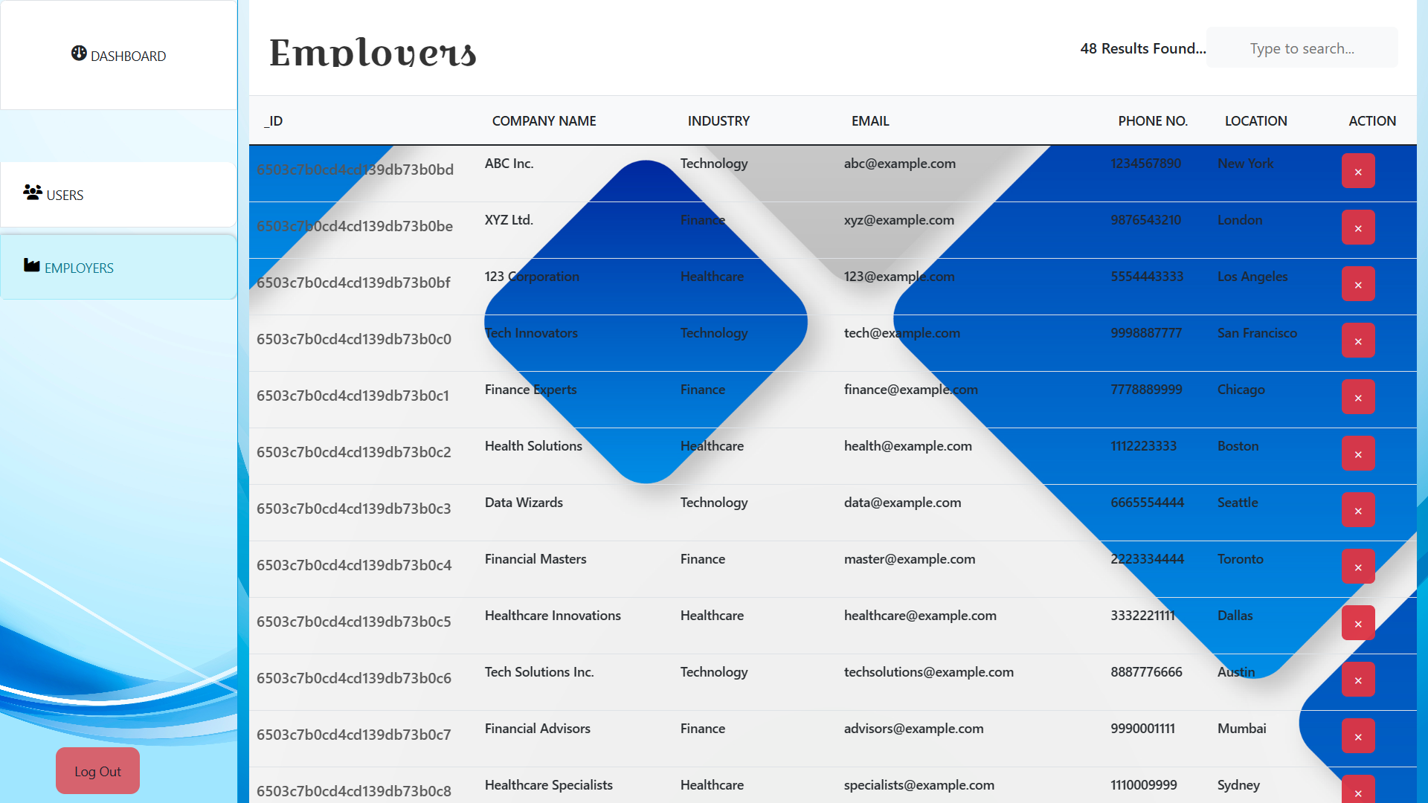
Employers Handling

Slide 32
Thanks for watching
By vimal bhesaniya

